Slide 1
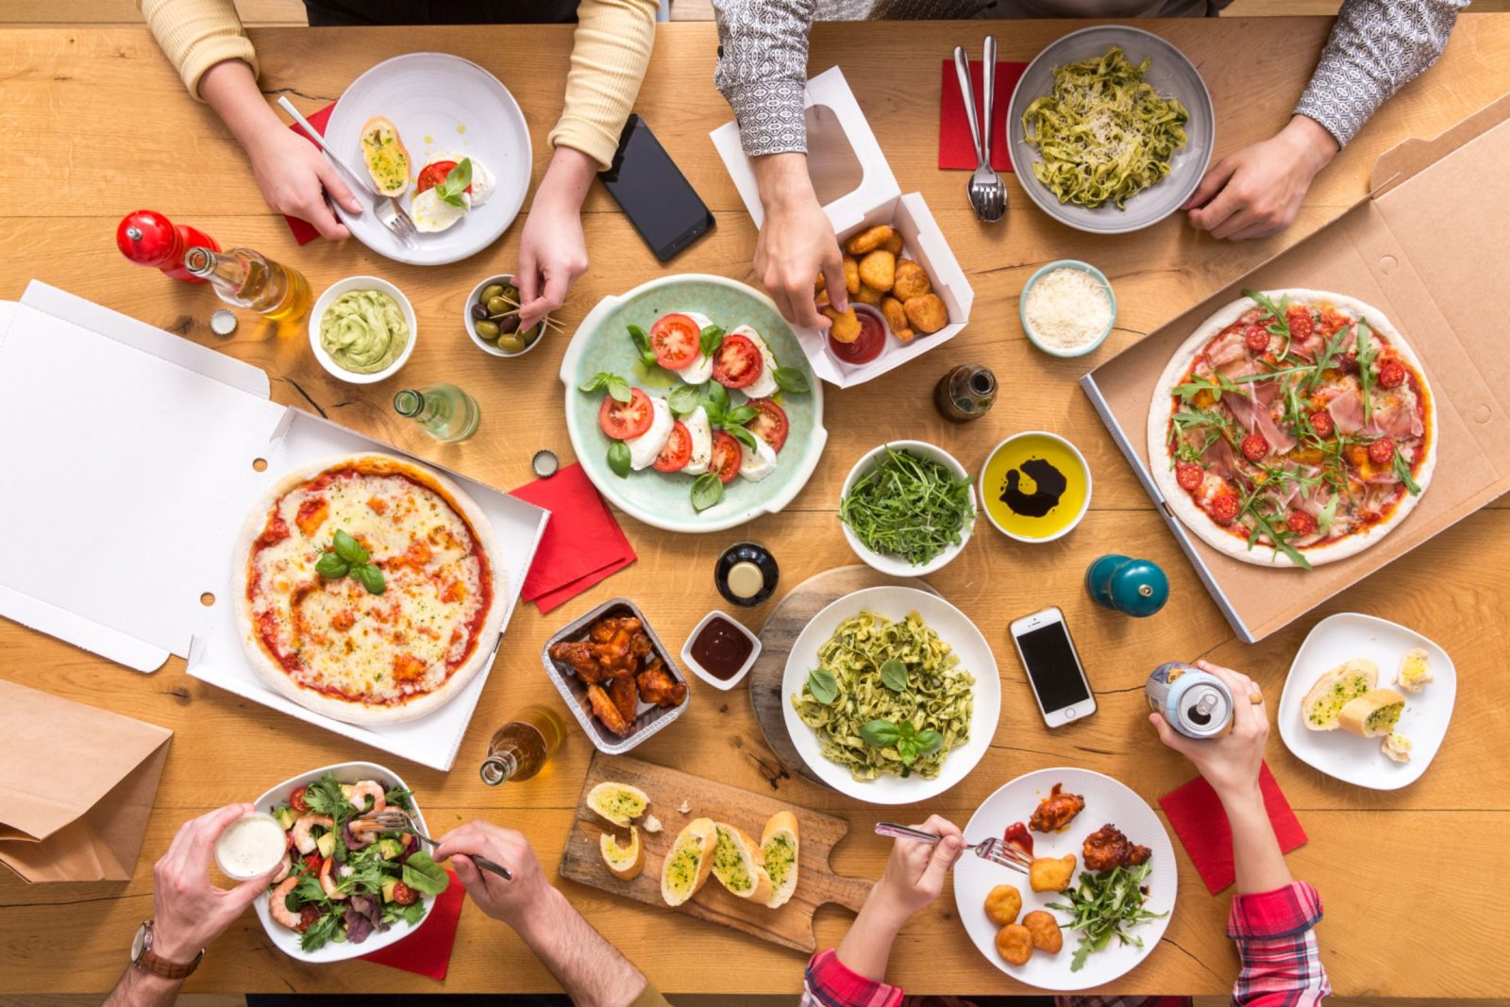






ONLINE PRE ORDERING SYSTEM
FOR RESTAURANTS
INTRODUCING TO SIMME PLATFORM

Slide 2




member of
INTRODUCTION
ABOUT SIMME PLATFORM
Current Situation
Customer Pain Releiver
Business Opportunities
Global Potential
Online Pre Ordering System
Deniz
Gjonson
Amala

Slide 3
member of
AS–IS SITUATION
PROBLEM IDENTIFICATION @ OFFLINE OPERATING RESTAURANTS
Orders take a long time prepare and serve
Restaurant administration issues / papers missing
Customer order is taken manually
Manual Management / Paper Based

Slide 4
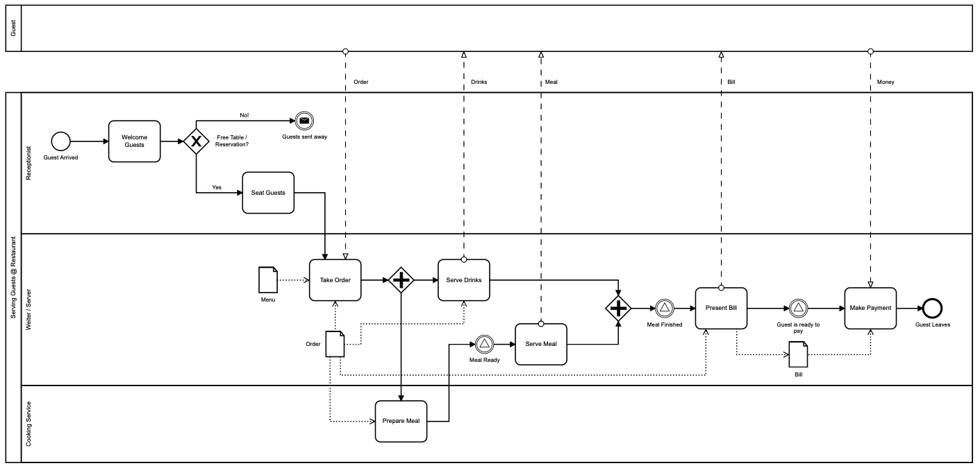
AS–IS PROCESS - BPMN
member of
OFFLINE OPERATING RESTAURANTS

Slide 5
member of
INTRODUCING THE SOLUTION
SIMME PLATFORM SOLUTION
Innovation
Online Pre Ordering System
Traditional vs. Digital
Hassle Free
Time Factor
Customer Satisfaction
Business Opportunity
“ If you want something new, you have to stop doing something old ”
William Pollard

Slide 6
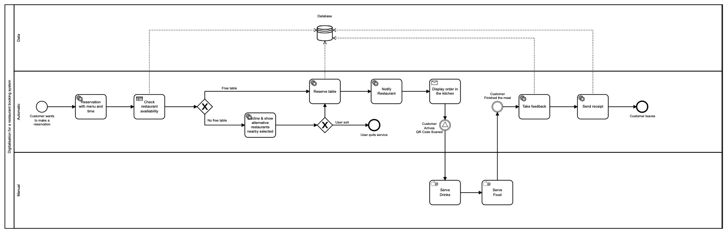
member of
member of
TO–BE PROCESS - BPMN
SIMME PLATFORM SOLUTION

Slide 7
member of
BUSINESS OPPORTUNITIES
SIMME PLATFORM SOLUTION
Digital Era / Society
Enables New Business Model
No Human Involvement
Relieves Customer Pains
Increases Profi
WHY?

Slide 8
member of
BUSINESS OPPORTUNITIES
SIMME PLATFORM SOLUTION
Kind of this Solution exists in CHINA!
It should work in EUROPE too!

Slide 9
member of
BUSINESS OPPORTUNITIES
SIMME PLATFORM SOLUTION
Restaurants
Chains
Franchises
Shopping Malls
Worldwide
WHERE?

Slide 10
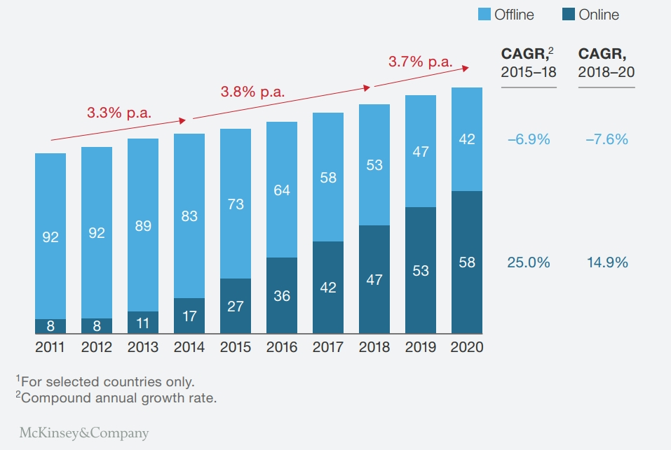
member of
member of
ONLINE ORDERING TRENDS
RESEARCH BASED
THE FOOD-DELIVERY MARKET HAS THE POTENTIAL FOR ROBUST GROWTH.
(McKinsey & Company, 2016)

Slide 11

member of
BENEFITS
SIMME PLATFORM SOLUTION
Reduce time
Flexibility
Predictable Costs
Customer Database
Tracking Orders
Marketing / Advertising
Customer Satisfaction

Slide 12
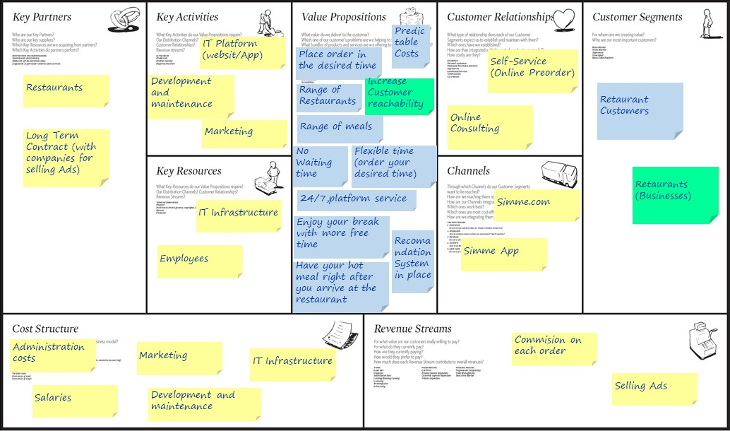

Slide 13
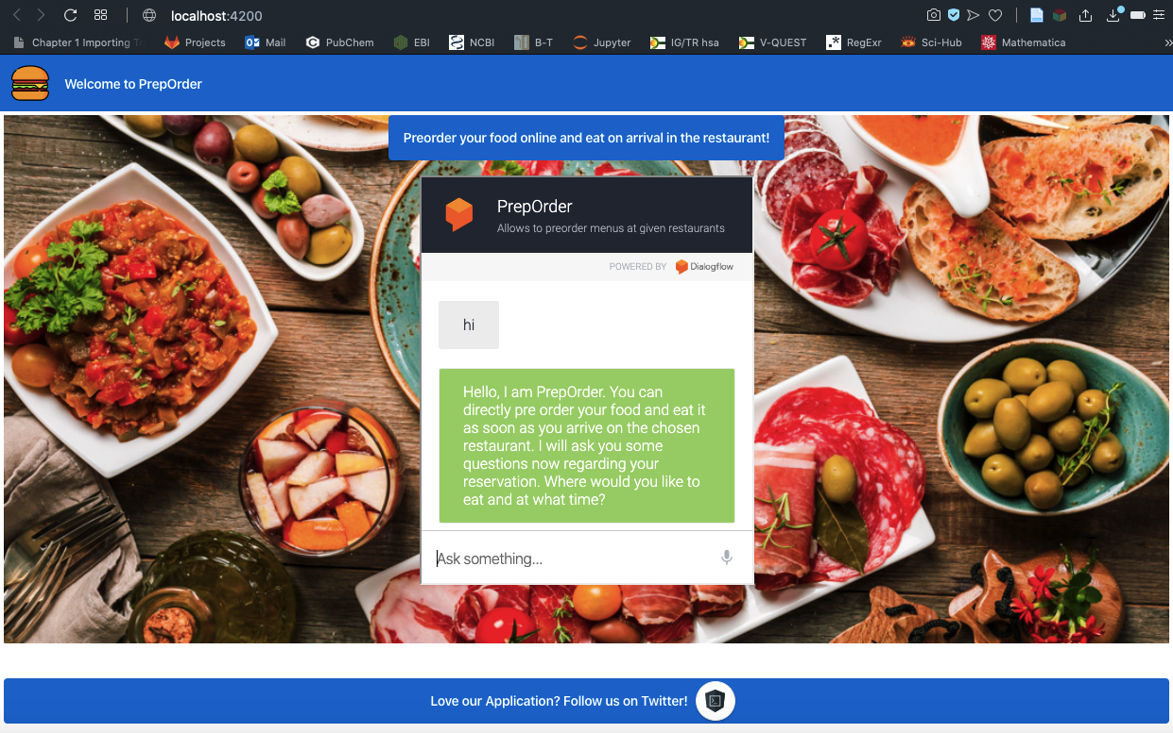
SIMME PLATFORM SOLUTION

Slide 14
member of
IMPLEMENTATION
SIMME PLATFORM SOLUTION
DEMO STUFF!!!

Slide 15
We appreciate your attention!
Thank You!
Questions? Feedbacks? Remarks?

